Slide 1
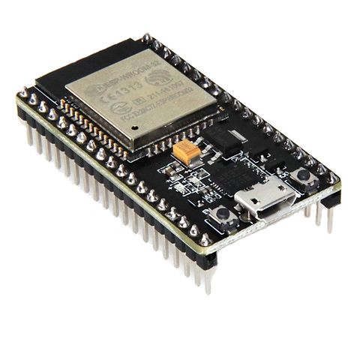
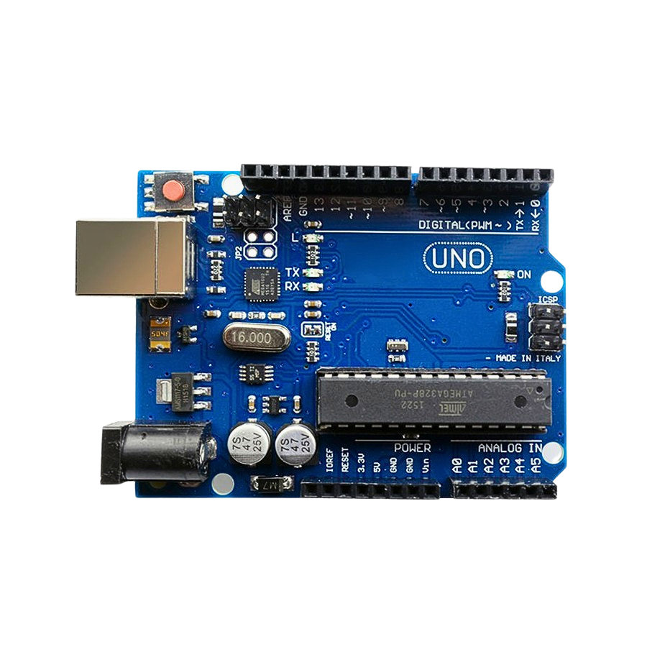
Project Presentation
By: Draix Wyatt, John Akujobi, Norman Nguyen, Sawyer Theis
Group: Arqer

Slide 2
Major Problems and Project Goals

Slide 3
Major Problems
Data Security and Privacy Risks: sensitive data leads to a potential target, to mitigate, we will comply with regulations such as GDPR and PCI DSS
Implementation of Video conferencing: we require video conferencing to support advisor meetings and events. We will use 3rd party API to Zoom, etc.
Payment: payment must be made secure as to not have theft of customer payments. We will use payment gateways from PayPal, Visa, etc
Managing Real Time Updates: News and Stock data require real time updates. We will cache any data feasible, and used sound database methods (ie. ACID)

Slide 4
Project Goals
Centralize WealthWise Services
The system shall centralize every service under one web app
Provide Accessibility to Certified Advisors
Users shall be able to consult with certified advisors under WealthWise’s employment/contract
Provide Advanced Financial Tools
Calculators shall be able to provide effective financial data and feedback

Slide 5
Project Goals Cont…
Provide Education and News Resources
The system shall provide access to external financial resources
Secure Payment to site
Payment to WealthWise shall be made secure and reliable
System Security Monitoring
The system shall be able to detect intrusions
Intuitive UI
Users shall not be often confused by UI

Slide 6
Structure of the proposal system

Slide 7
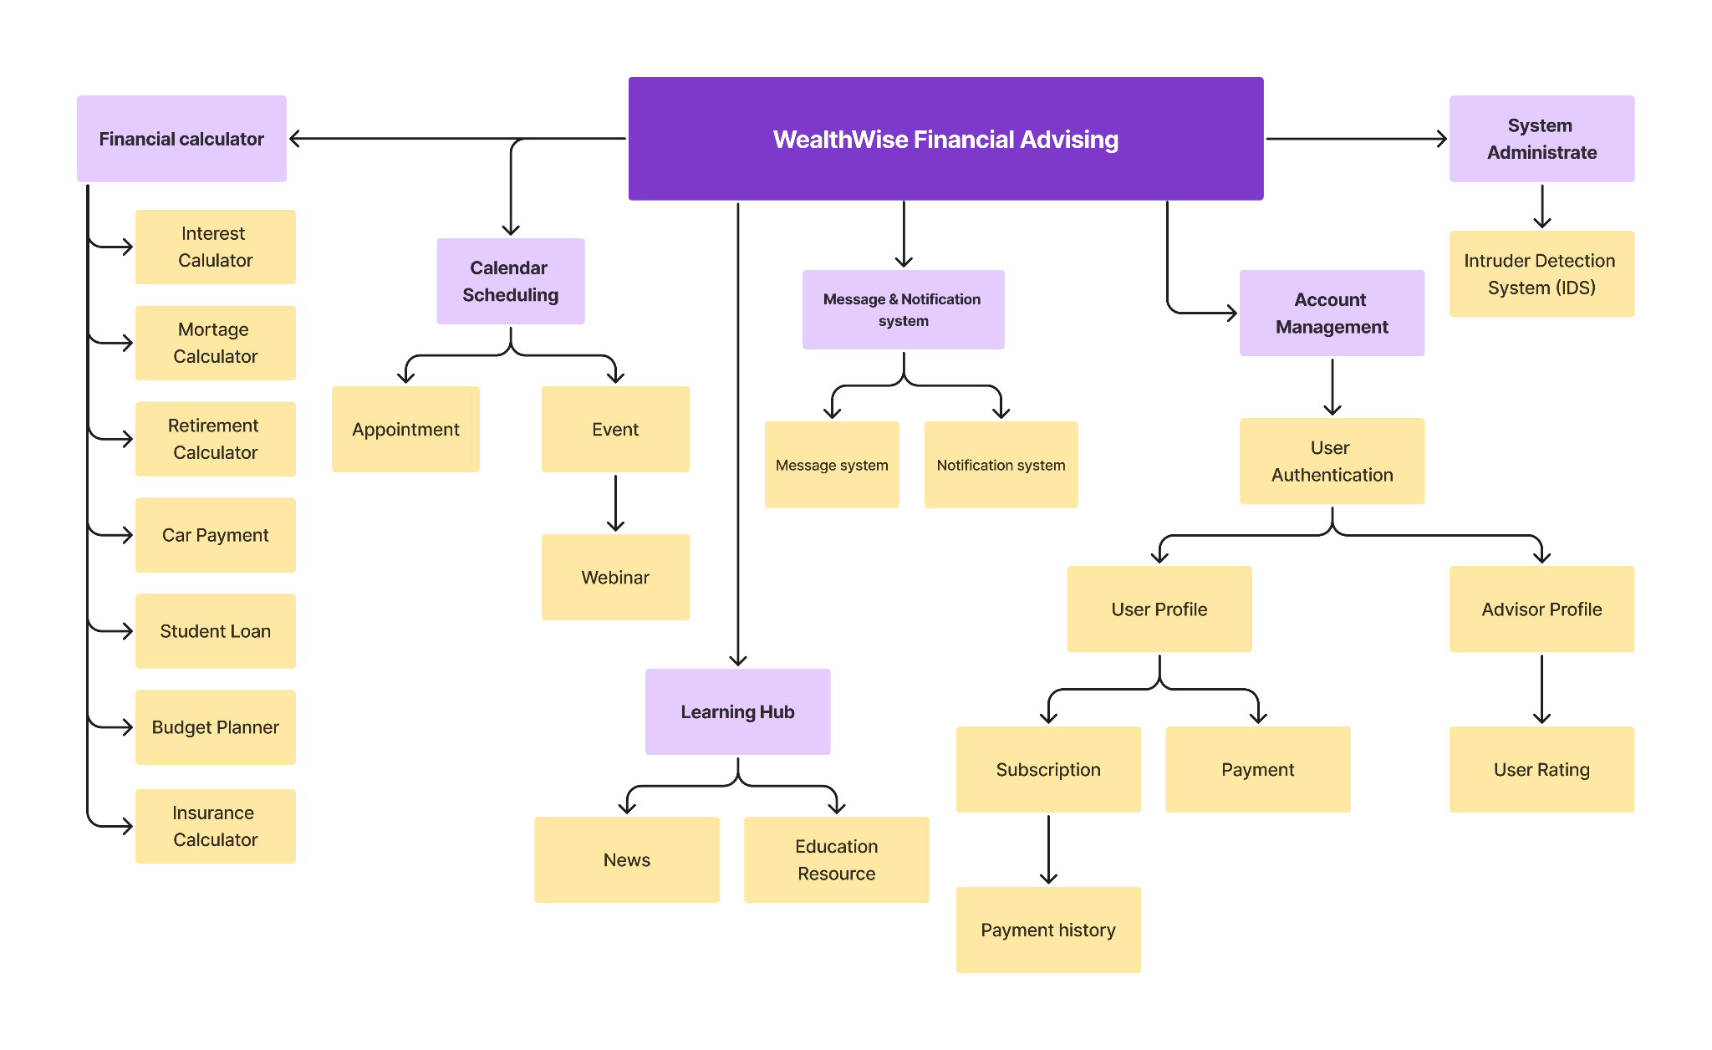

Slide 8
Architecture Design

Slide 9
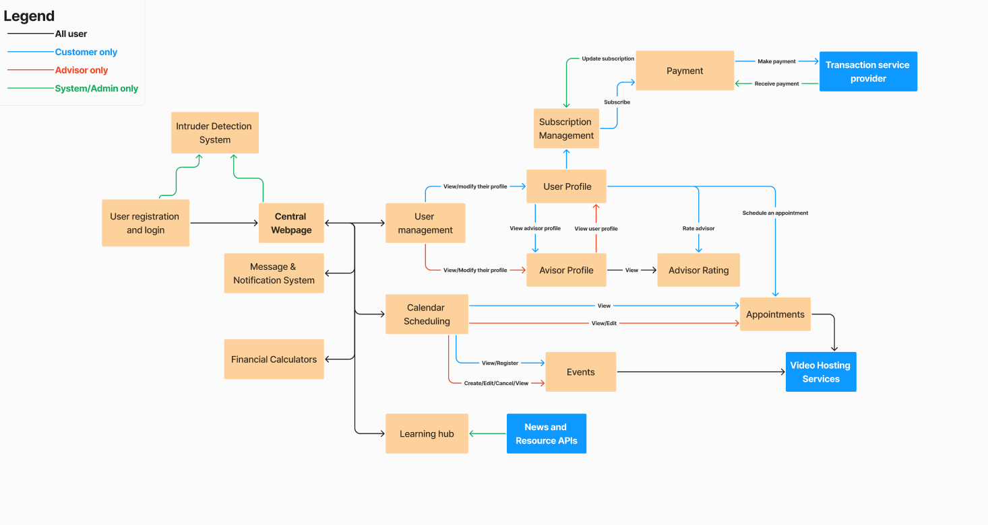
Architecture Design

Slide 10
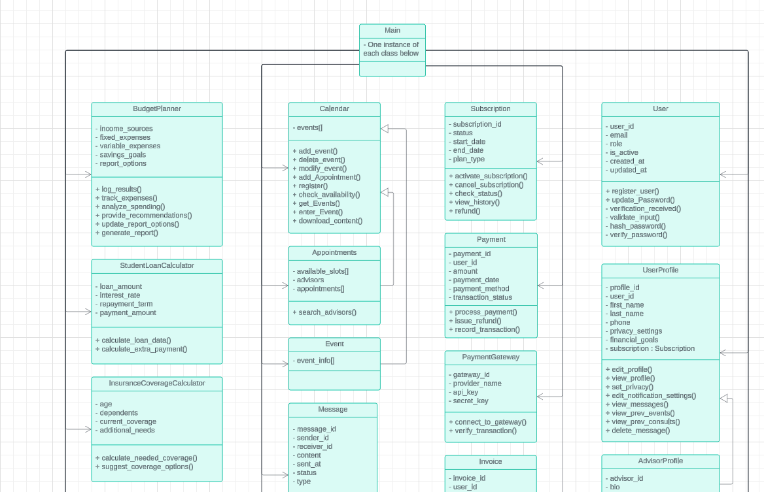
Class Diagram

Slide 11
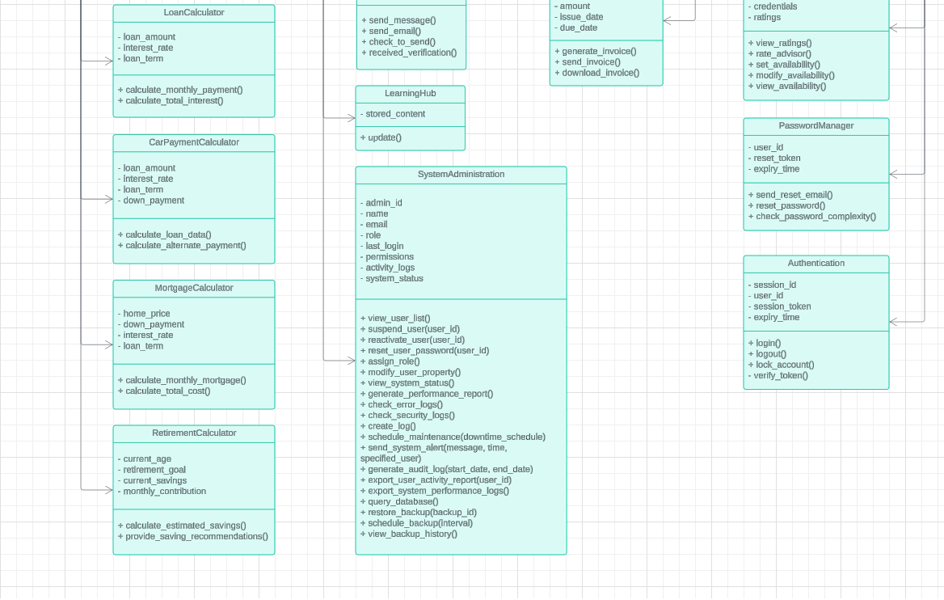
Class Diagram (cont)

Slide 12
Database Design

Slide 13
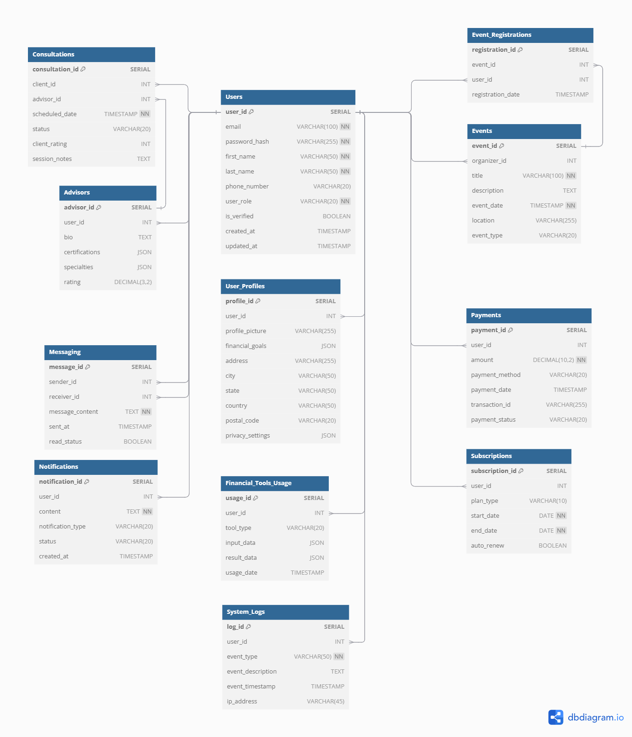
Database Design
Users: contain email, hashed password, first name, last name, phone number, role, verification status, creation date, update date.
User profiles: contain profile ID, user ID, profile picture, financial goals, address, city, state, country, postal code, privacy settings.
Advisors: contains advisor ID, user ID, bio, certifications, specialties, rating.
Consultations: contains consultation ID, client ID, advisor ID, scheduled date, status, client rating, session notes.
Event registrations: contains registration ID, event ID, user ID, registration date.
Events: contains event ID, organizer ID, title, description, event date, location, event type.
Notifications: contains notification ID, user ID, content, notification type, status, created at.
Messaging: message ID, sender ID, receiver ID, message content, sent at, read status.
Payments: contains payment ID, user ID, amount, payment method, payment date, transaction ID, payment status.
Subscriptions: contains subscription ID, user ID, plan type, start date, end date, auto renewal.
Financial Tools Usage: contains usage ID, user ID, tool type, input data, result data, usage date.
System logs: contains log ID, user ID, event type, event description, event timestamp, IP address.

Slide 14
Data flow

Slide 15
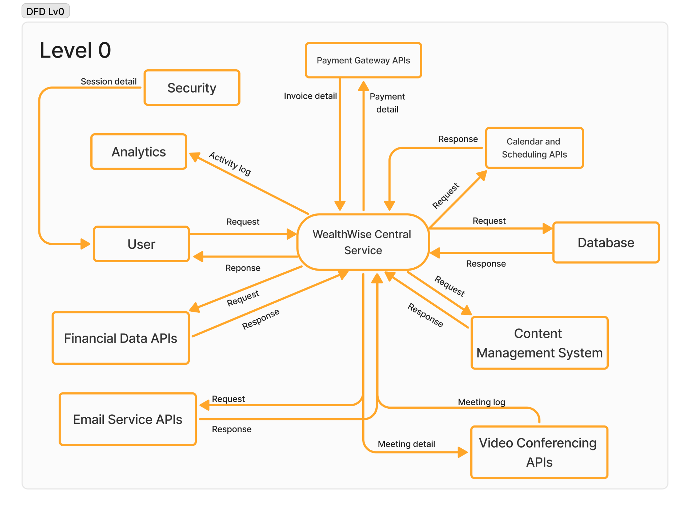

Slide 16
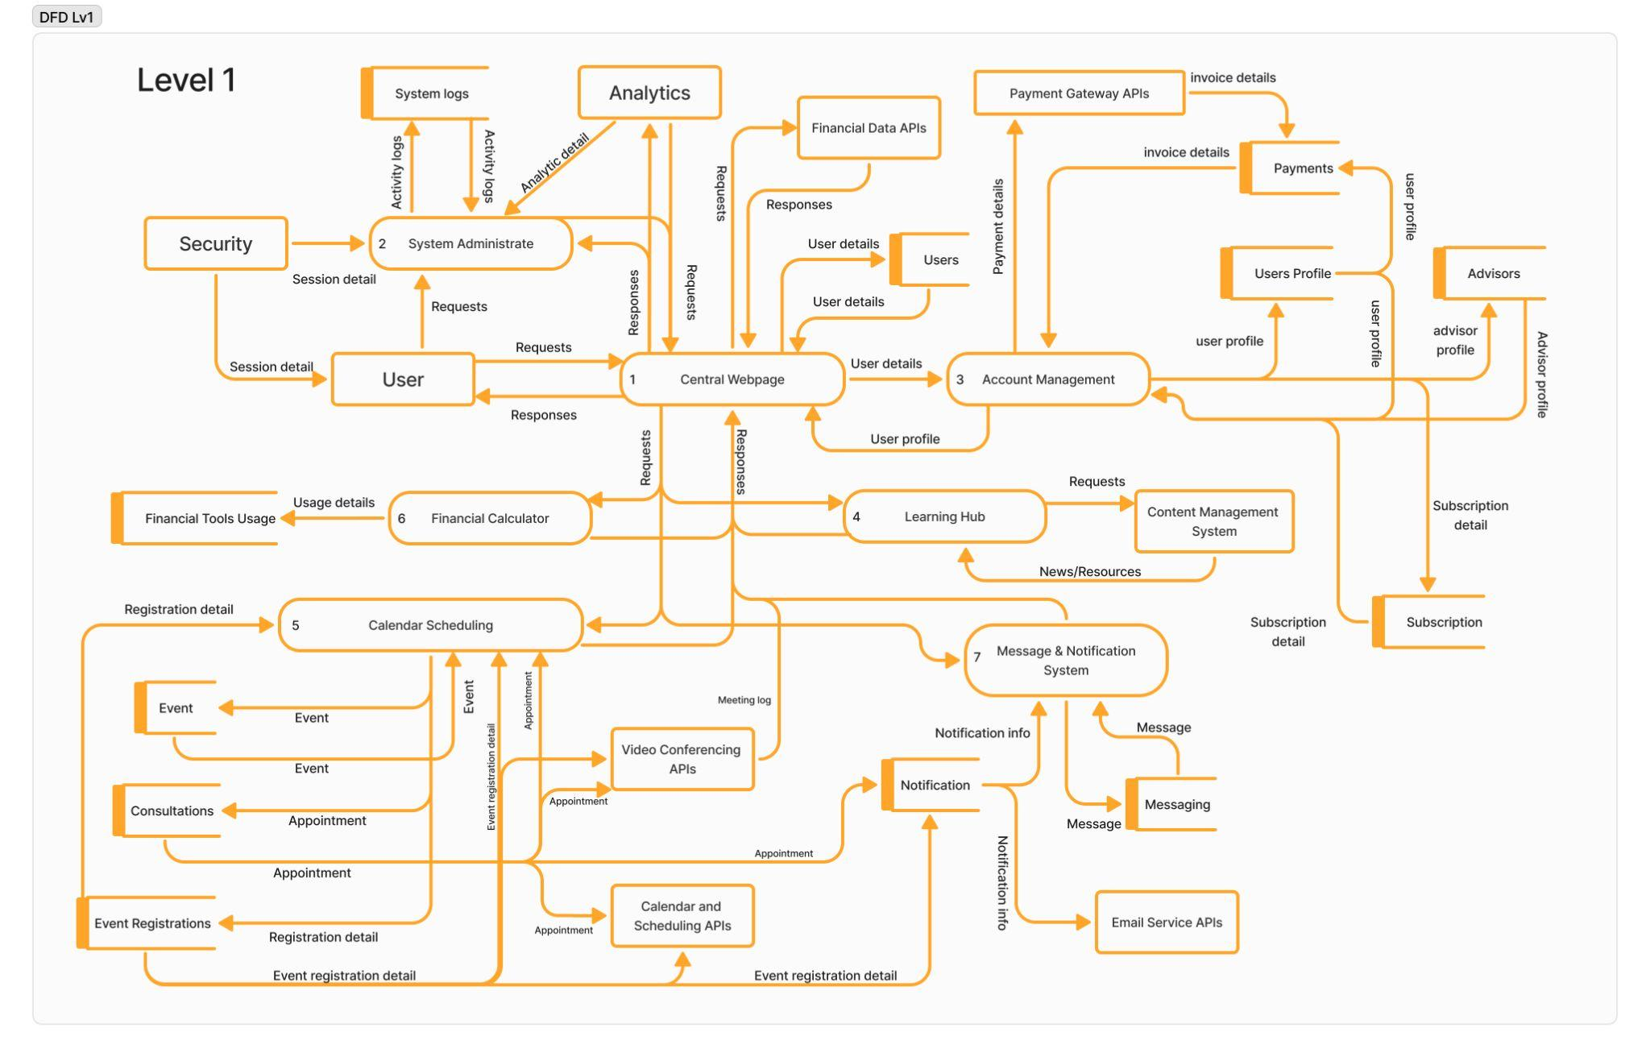

Slide 17
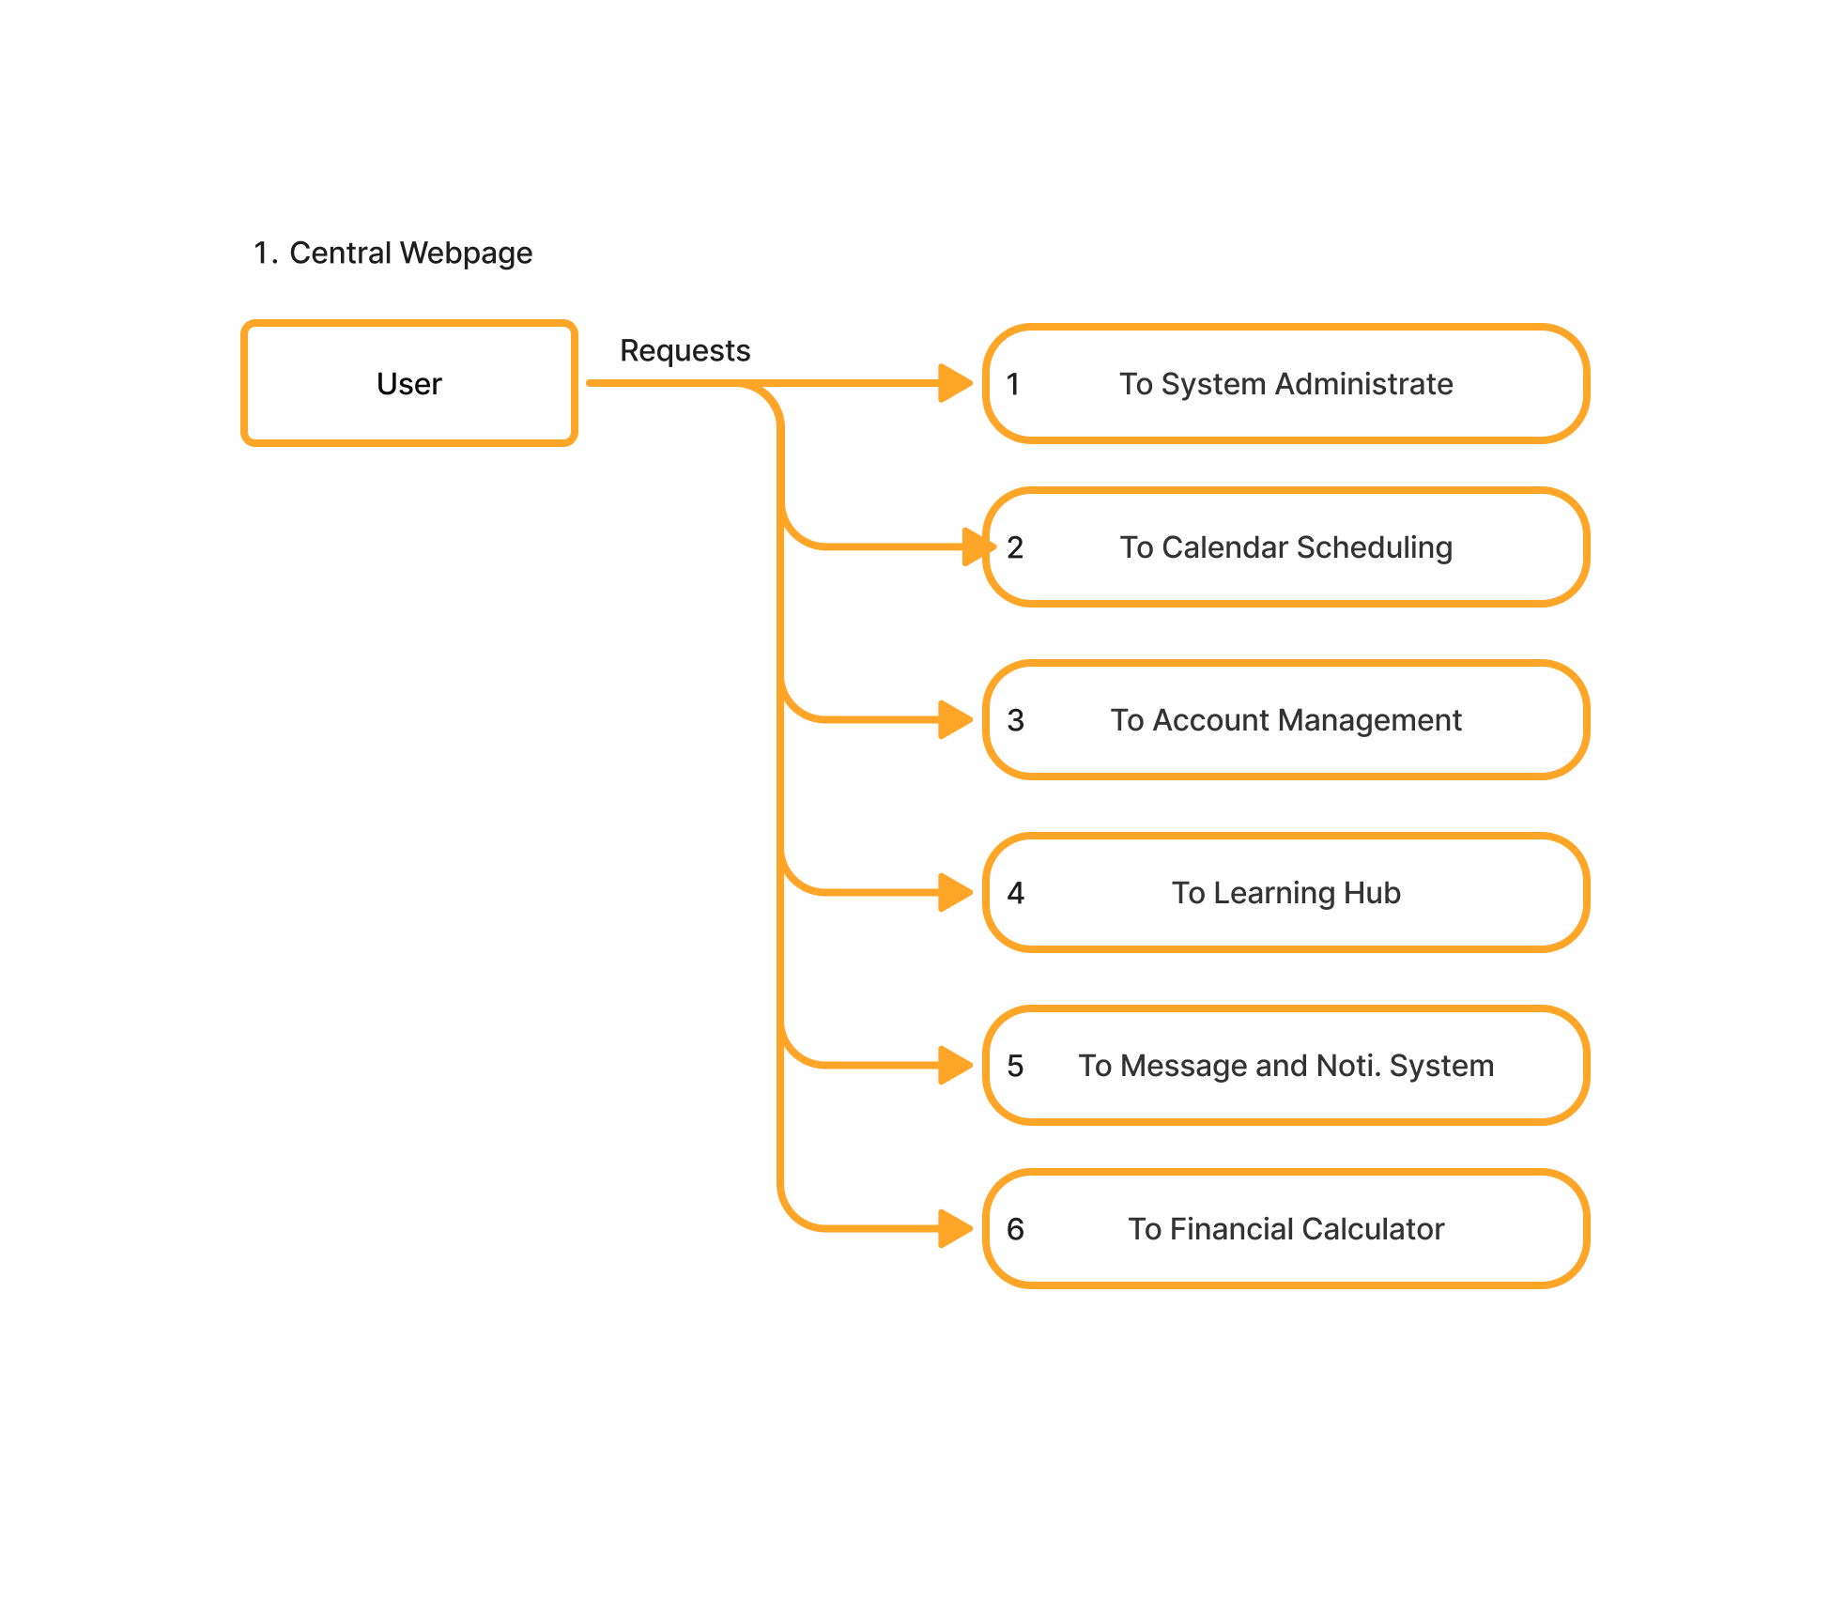
Central Webpage

Slide 18
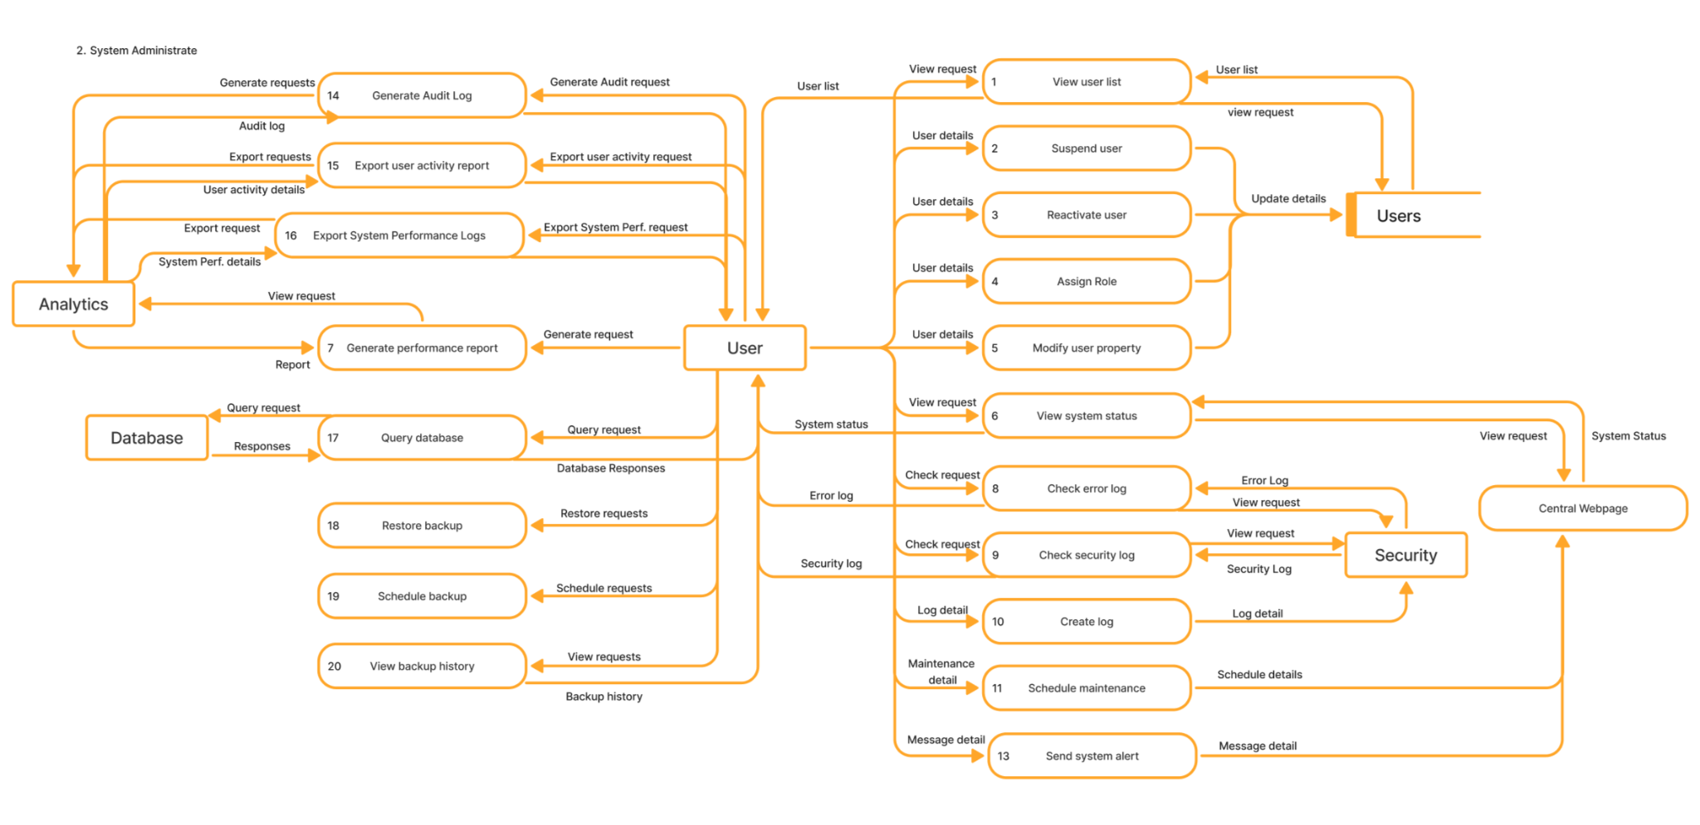
System Administrate

Slide 19
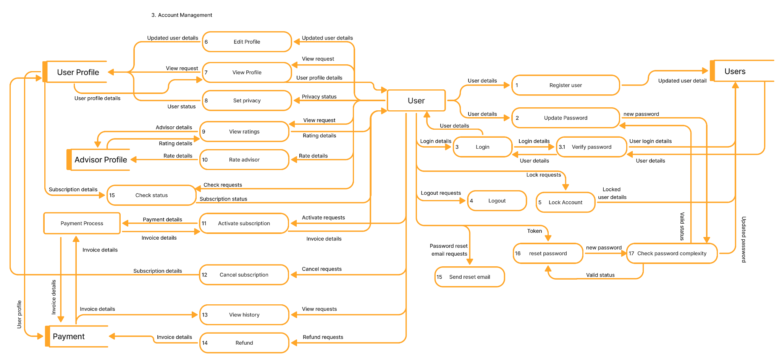
Account Management

Slide 20
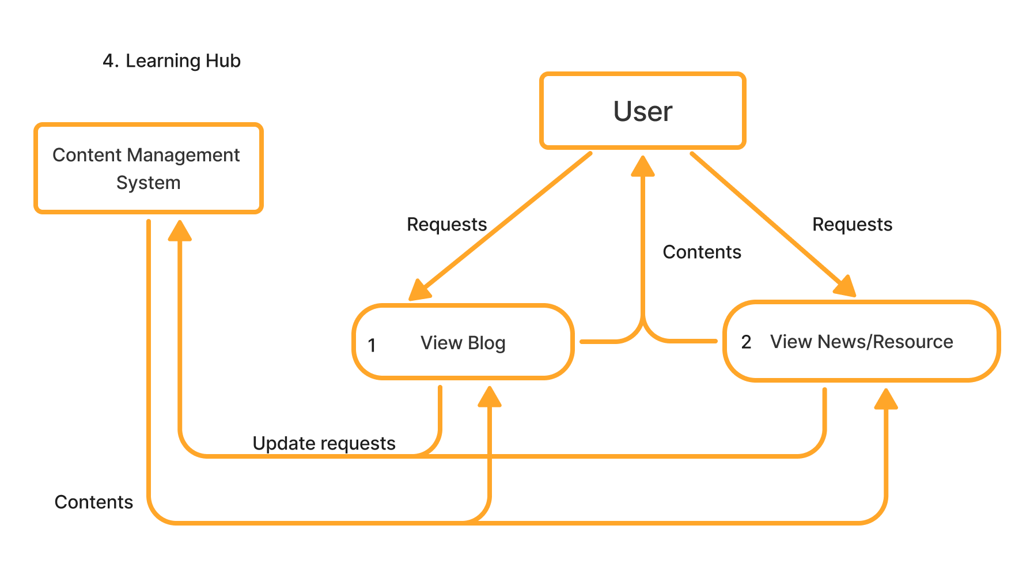
Learning Hub

Slide 21
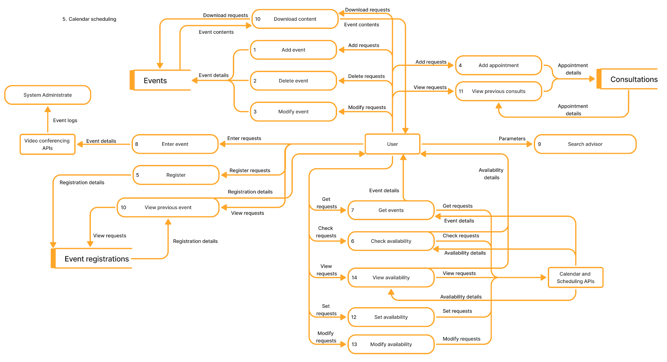
Calendar Scheduling

Slide 22
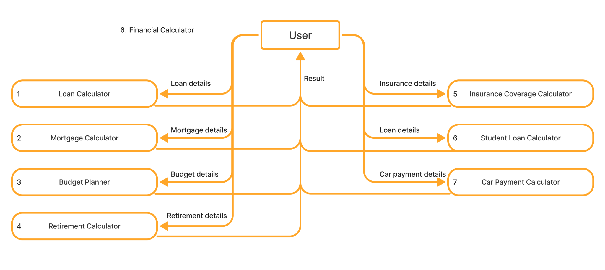
Financial Calculator

Slide 23
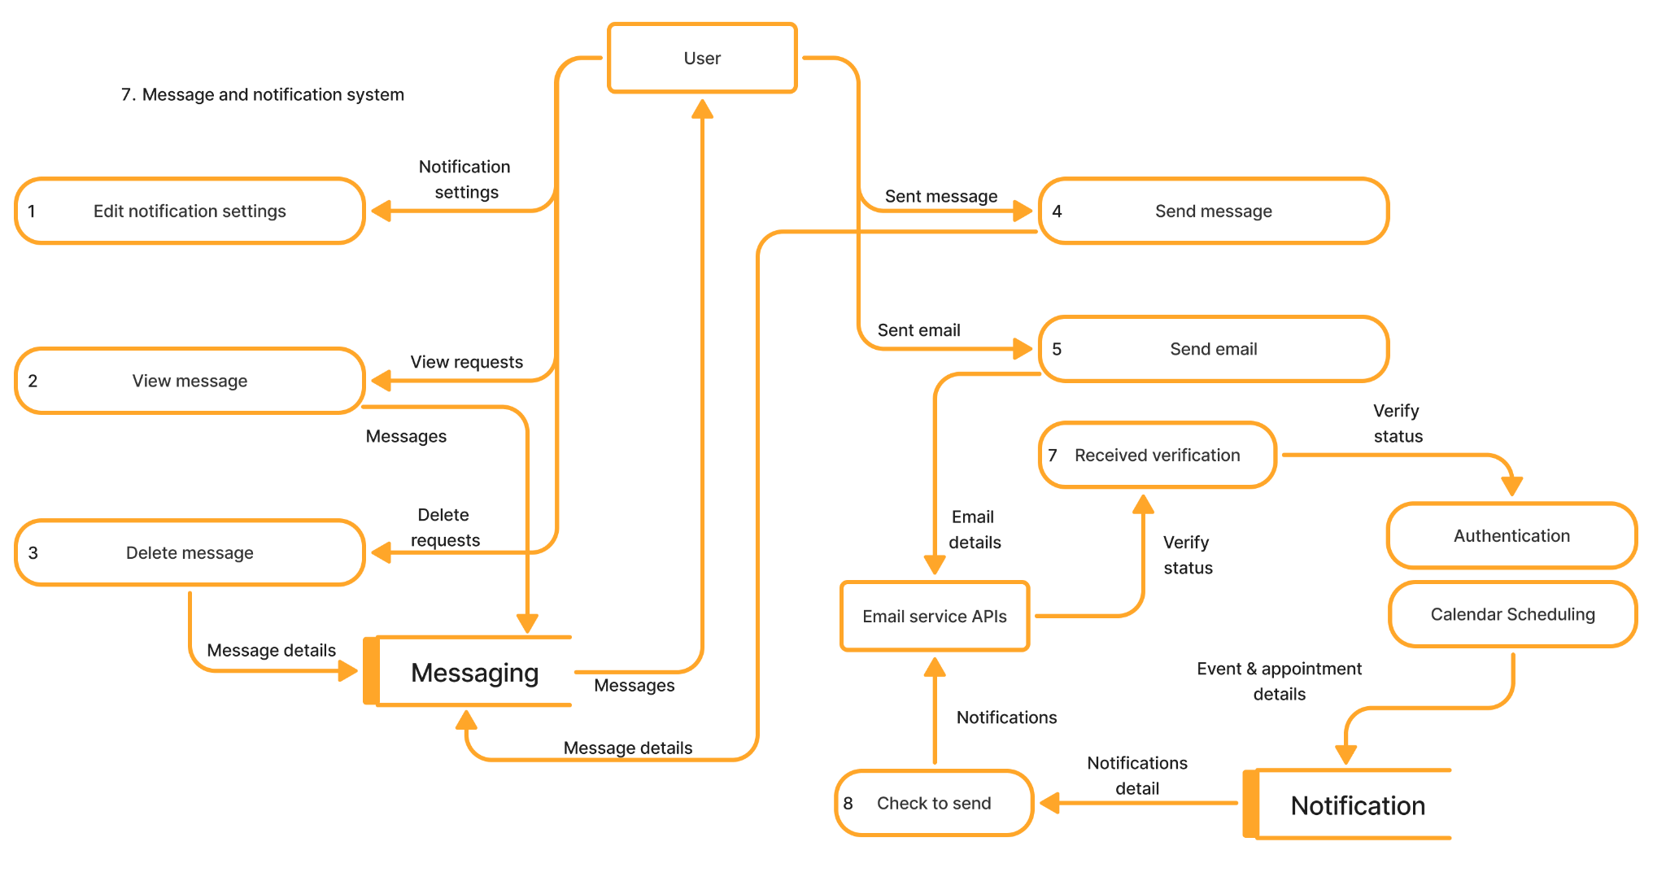
Message System

Slide 24
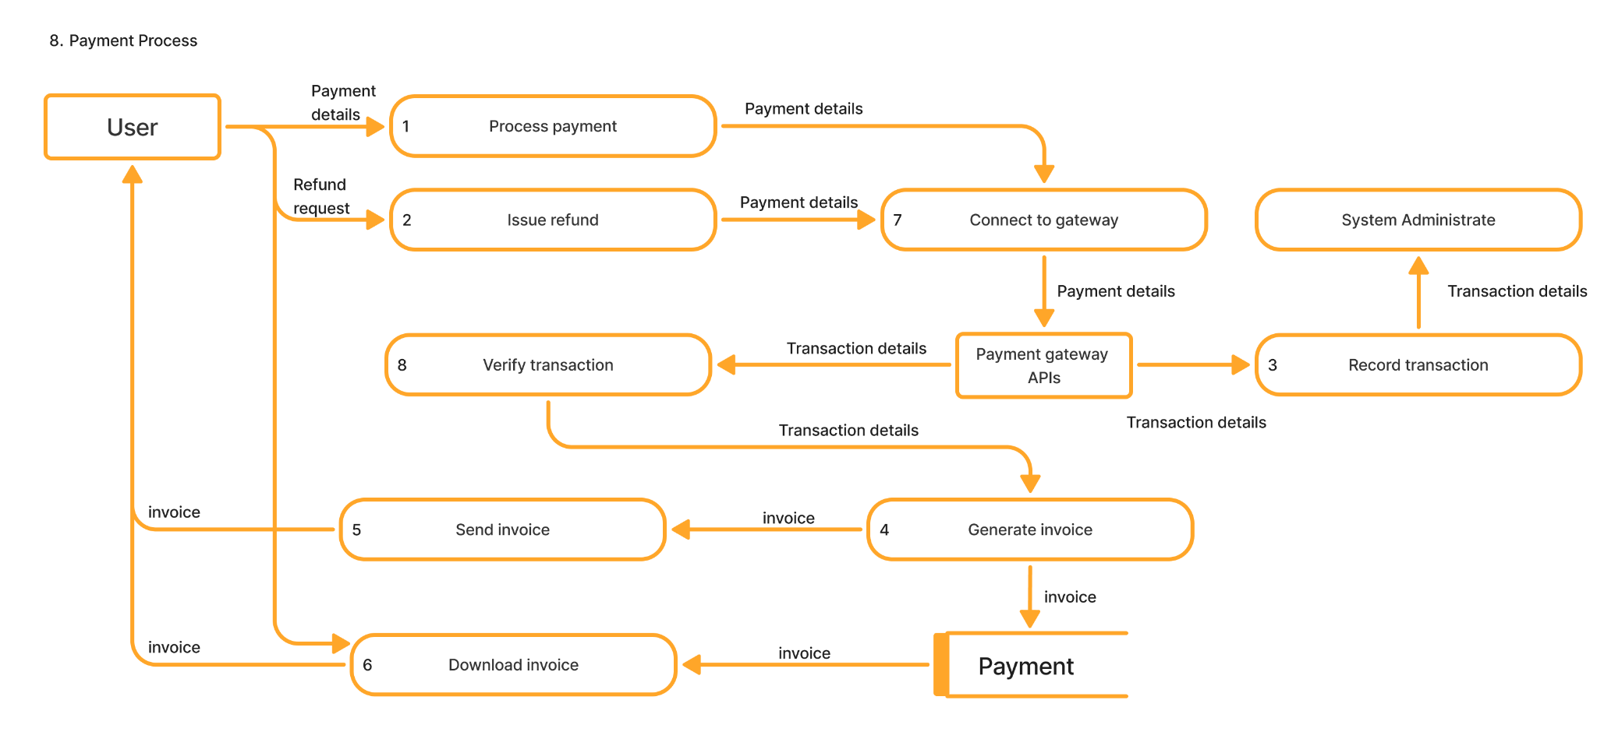
Payment Process

Slide 25
Technologies and Tools

Slide 26
Technologies and Tools
Component | Primary Choice | Language | Reasoning
Frontend | Next.js | JavaScript | Next.js gives us extensive library support, allows us to resuse components, and improves SEO through server rendering. This is good for our complex application with dynamic content
Backend | FastAPI | Python | FastAPI is lightweight, fast, and async-capable, making it suitable for a scalable API-focused app.
Database | PostgreSQL | SQL | PostgreSQL provides reliability and scalability, whereas SQLite could be simpler but less robust.
Deployment | Namecheap + C-Panel + Cloudflare | - | Namecheap with C-Panel and Cloudflare is cost-effective for small deployments. Heroku/Vercel offers auto-deployment but with potential cost and configuration limitations.

Slide 27
Challenges and Solutions

Slide 28
Challenges and Solutions
Team experience level: Our team members have varying experience levels in different technologies and tool.
To balance this, we must communicate clearly, explain concepts and assist members to learn various tools and system features. Furthermore, we will divide and assign tasks and assign based on member’s preference and experience. However, at minimum, all members are required to understand the fundamentals of the system design and features.
Team consistency: Our team members have different ways and times of working, and sometimes, this makes it's challenging to maintain a standard and cohesiveness.
To solve this, we agree on standards and conventions for our work. For communication, we use a mix of asynchronous messaging, voice & video calls, and in-person meetings that we collectively schedule ahead for.

Slide 29
Challenges and Solutions (cont.)
Tech decision: With limited experience in building actual software implementations and testing, we struggled to determine the best approach for the project, including what tools to use, our tech stack, and how to deploy. - To overcome this, we read articles and researched other existing software to understand their deployment and testing methods. With this knowledge, we tested them to see if they fit our requirements.
Managing team assets: Because several components are in different tools and work areas, it is sometimes tricky to find material that we need. - We will allow members to use whatever they want to work, but all the material must be pushed to the GitHub repository. For documents, we use a central Notion workspace which is subsequently converted into a Word document where it is further formatted for submission.

Slide 30
Conclusion

Slide 31
Conclusion
Project Objectives
Centralize WealthWise Services
Provide Access to Advisors
Provide Financial Tools
Provide Education and News Resources
Intuitive User Interface
Est. Cost- $0.00
Est. Time to Completion- 4 months

